Slide 1
Supporting the Educational and Mental Well-Being of Black Families During and Post COVID-19
April 19th, 2021
Maya K. Bracy, Meghan J. Greene, Dana Griffin, Ph.D., Marisa Marraccini, Ph.D.,
Maya Hardrick, Ashley Cates

Slide 2
  "I just feel like some of the White friends that I have come in contact with don’t totally understand the impact of COVID on people of color."

Slide 3
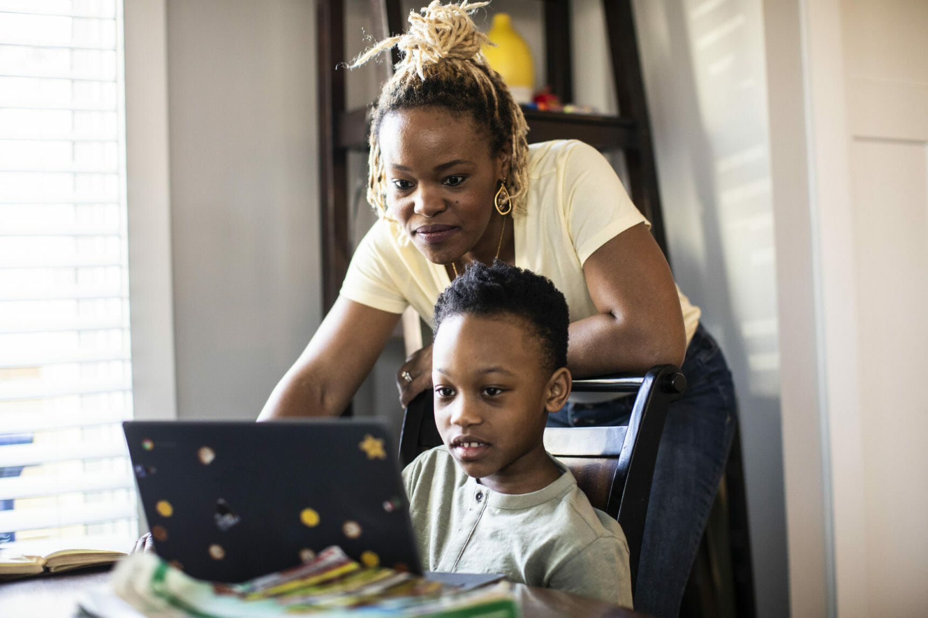
OVERVIEW
Why are we interested in the experiences of Black families during the COVID-19 pandemic?
How did we collect and measure those experiences?
What are we learning from conversations with Black parents about their experiences?

Slide 4
Literature Review
Black Americans were more likely to contract and die from COVID-19 at rates higher than any other racial population¹
School personnel are often untrained in antiracist practices
School personnel lacked training to support students and their families during this health crisis²
¹Ollove & Vestal, 2020; ²Golberstein et al., 2020

Slide 5
BACKGROUND
Black parents in North Carolina felt their concerns and realities were not being considered in school decisions (Brown, 2021a; Henderson, 2020)
Black parents and community leaders voiced concerns regarding safety of the most vulnerable populations (Brown, 2021b; Krueger, 2021)

Slide 6
STUDY SETTING
Mid-sized city in North Carolina
39% identify as Black, 20% of whom live in poverty.
Nearly 10,000 cases of COVID-19, the majority of which were among people of color, at the height of the pandemic
Notes:
Demographic data re: durham [do we want a graph here? graph is a placeholder (data is accurate, thought) – I'll fix formatting after we chat]
- population by race (do we want income distribution or median income?)
- public school enrollment by race
**does it matter that the years are different? I have the most recent published census data (that I could find) and the 2019-2020 school enrollment data
TEXT: City in Southeast United States
Question: how do we cite data without revealing location? I'm pulling from the census bureau data

Slide 7
STUDY SETTING

Slide 8
STUDY AIMS
Discover the experiences regarding educational and mental health of Black families during the pandemic;
Learn how parents were involved with their children during the pandemic; and
Develop culturally appropriate interventions school stakeholders can use to support Black students now that schools have reopened.

Slide 9
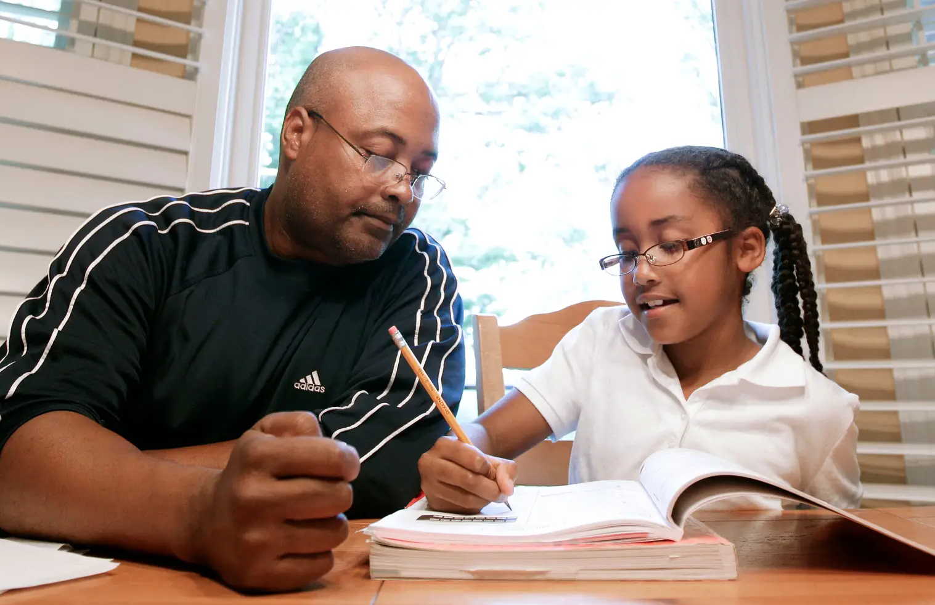
RECRUITMENT & DATA COLLECTION
Black or African American parents
At least one child in K-12th grade
5-minute interview
Parent-report Questionnaires
  Demographic survey
  PHQ-9, self-report and parent report
  GAD-7
  SCARED, Parent Version
  SDQ, Parent Report
  School Climate Diversity Scale
Parent Focus Groups
Notes:
We recruited parents who identified as black or African American and had at least one child in kindergarten through 12th grade, from the surrounding area.
Those interested parents were then asked to participate in a brief 5-minite interview a series of questionnaires assessing factors of parent and child mental health, and finally they were asked to participate in a focus group with other parents on the topic of their past and present experiences of school and mental health as Black parents during the COVID-19 pandemic.

Slide 10
DATA ANALYSIS
Qualitative​
Inductive coding of focus groups (n = 2) and 5-minute interviews​ (n=5)
Generated emerging codes and identified themes
Quantitative​
Generated child and parent profiles
Notes:
Qualitative
•Five-minute interviews and focus groups were transcribed and coded inductively (Glaser & Strauss, 1978)
•Emerging codes were generated and themes between codes were identified
Quantitative
•Child and parent profiles were generated using questionnaires to enhance qualitative analysis
[we are going to focus on our preliminary qualitative results and the themes that emerged from our first focus group]
We took the conversations from parents in the focus groups and 5-minute interviews and developed a code book full of reoccurring ideas or experiences that our parents were sharing and from there have identified some key themes that are emerging from this preliminary data.
We also generated child and parent mental health profiles using quantitative analysis of the questionnaire data, however for the purposed of today we are just going to focus on our preliminary qualitative results and themes that emerged from our first focus group.

Slide 11
QUALITATIVE THEMES
COMMUNITY
RACIAL BIAS
PARENT INVOLVEMENT

Slide 12
QUALITATIVE THEMES
COMMUNITY
"So I think for me, the biggest thing was having to find resources outside of the school. Meaning like, engaging with other moms who are going through the same thing."
RACIAL BIAS
PARENT INVOLVEMENT

Slide 13
QUALITATIVE THEMES
COMMUNITY
"So I think for me, the biggest thing was having to find resources outside of the school. Meaning like, engaging with other moms who are going through the same thing."
RACIAL BIAS
"We didn’t have any of those connections. I watched their kids. They helped supervise my kid. One morning the lady couldn’t get her son to the bus and I was able to help her, but none of that would have happened had quarantine and COVID not happened."
PARENT INVOLVEMENT

Slide 14
QUALITATIVE THEMES
COMMUNITY
"Black students are doing better academically because it has removed some of the roadblocks that definitely get in their way. And when a teacher can only see your work, right. They don’t see how you come dressed, they don’t see maybe all the things that they would normally make judgements about you for, that’s not there."
RACIAL BIAS
PARENT INVOLVEMENT

Slide 15
QUALITATIVE THEMES
COMMUNITY
"Black students are doing better academically because it has removed some of the roadblocks that definitely get in their way. And when a teacher can only see your work, right. They don’t see how you come dressed, they don’t see maybe all the things that they would normally make judgements about you for, that’s not there."
RACIAL BIAS
"I want the teachers to respect my kids. I don’t want them group them as, 'Oh, those kinda kids that I don’t expect much from them just because they’re Black.'"
PARENT INVOLVEMENT

Slide 16
QUALITATIVE THEMES
COMMUNITY
"And a lot of the Black moms were like, 'Girl, I’m not going to that.' And I was like, 'Just come, just come.' And then there’s a lady to this day that says, 'I cannot believe you’ve got me being an involved parent.' But it’s important right, like it’s important for your kid."
RACIAL BIAS
PARENT INVOLVEMENT

Slide 17
QUALITATIVE THEMES
COMMUNITY
"And a lot of the Black moms were like, 'Girl, I’m not going to that.' And I was like, 'Just come, just come.' And then there’s a lady to this day that says, 'I cannot believe you’ve got me being an involved parent.' But it’s important right, like it’s important for your kid."
RACIAL BIAS
"Not all families feel welcomed when they’re coming into a school setting for various reasons. It could be personal experience or things that have happened in the past with their children but trying to set an environment where they feel welcomed to come in."
PARENT INVOLVEMENT

Slide 18
DISCUSSION – What We Know
The pandemic disproportionately affected communities of color^{1,2}
Many concerns raised around "learning loss" and psychological distress in children and youth³
While non-Latinx White parents advocated for school-reopening, the voices of Black parents were invisible⁴
¹Maldonado & De Witte, 2020; ²Engzell et al., 2020; ³Agostnelli et al., 2020; ⁴Roesch, 2020
Notes:
- there is a misconception that Black parents are not involved in their child's educational experiences
- the pandemic removed many of the barriers for parents to be involved in their child's schooling
- it is necessary to give Black parents a voice in the decision-making process for their child's schooling

Slide 19
DISCUSSION – What we are learning
The pandemic removed many of the barriers that limited traditional parent involvement in their child's schooling
Parents are aware of the racial bias that their children experience in schools; racial bias which the pandemic was able to remove
We now have more data validating the deficit ideology of parent involvement of Black parents
Black parents have insight and knowledge that we need to tap in to by giving them a voice in the decision-making processes for their child's schooling

Slide 20
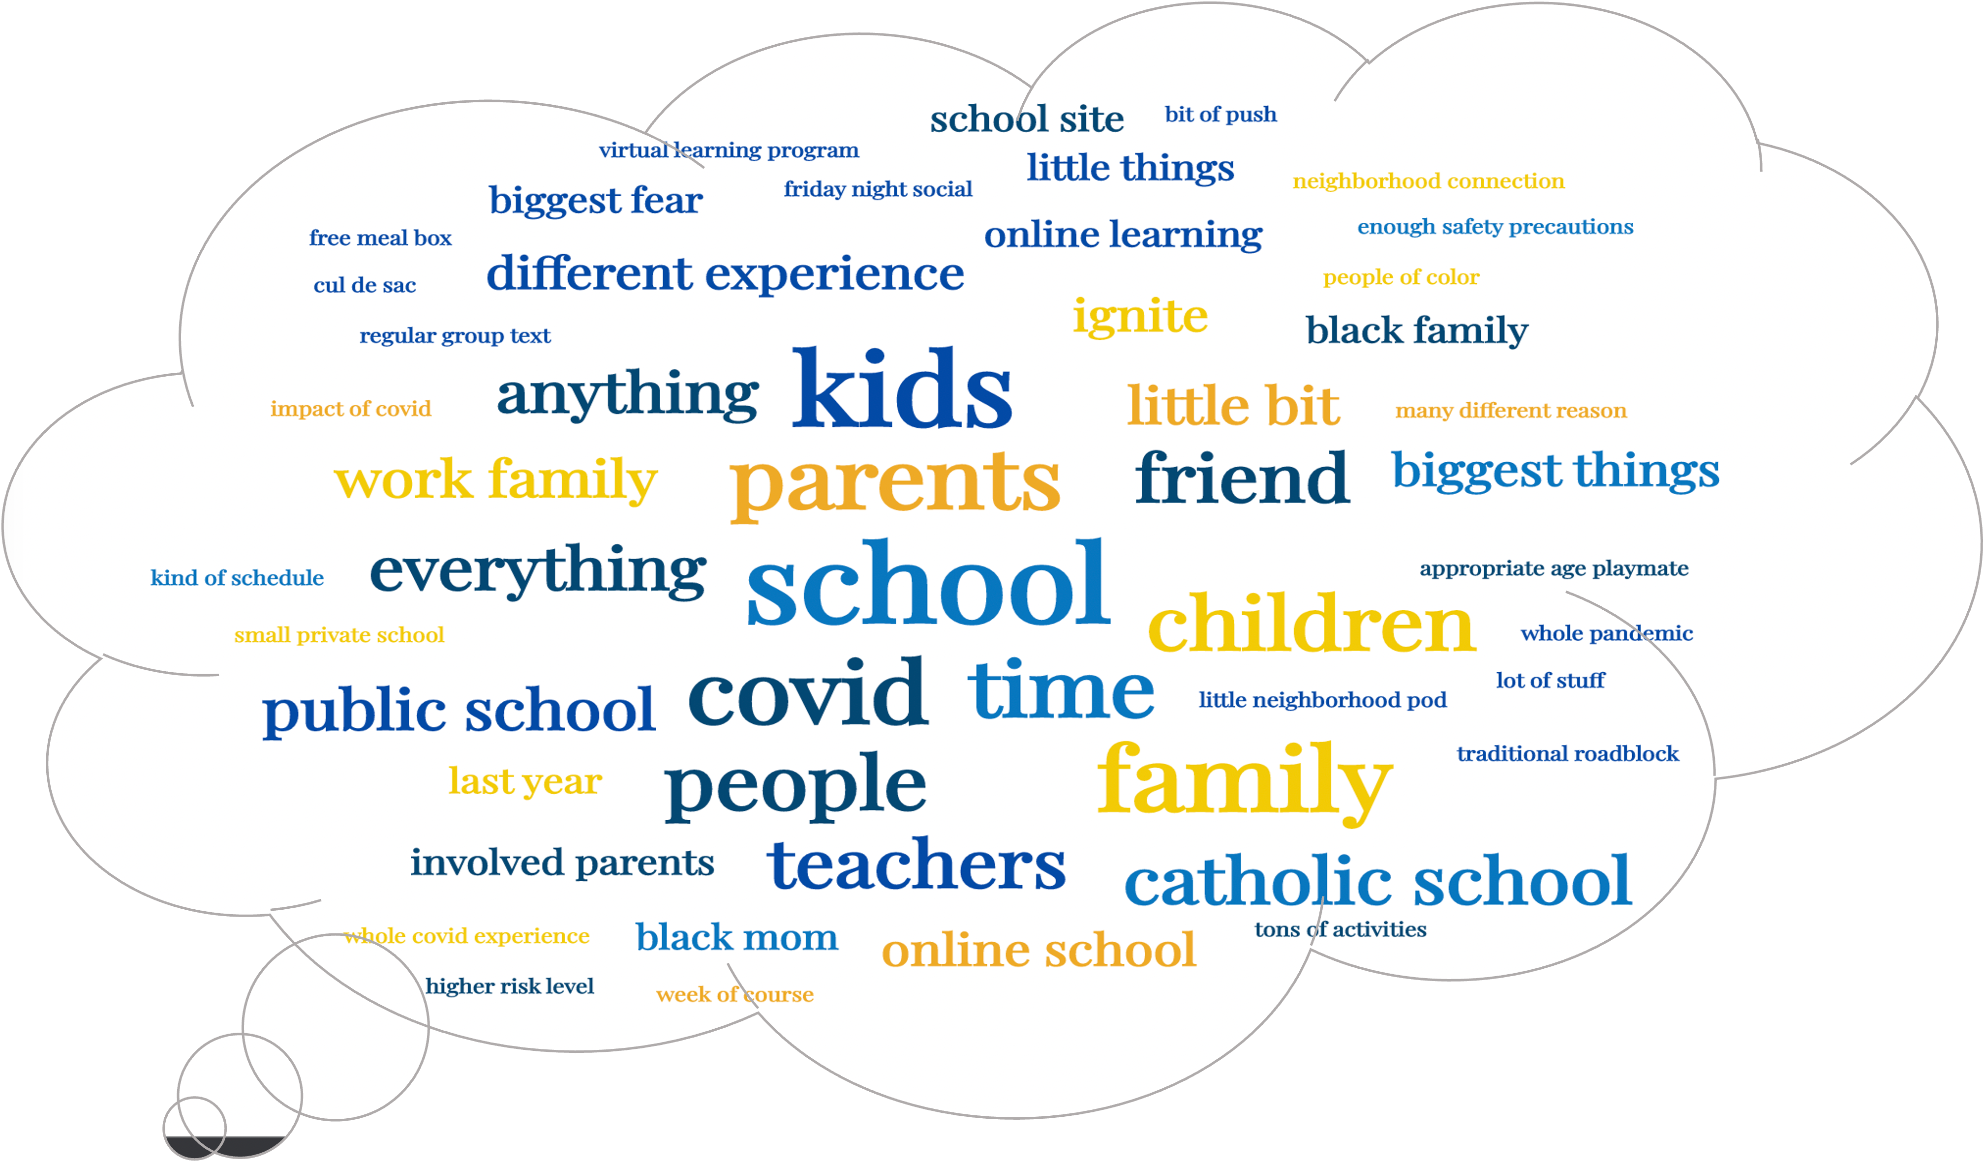
Notes:
These methods were fruitful in collecting a lot of information on the experiences of Black parents and their children during the pandemic

Slide 21
THANK YOU!
We would like to thank the Tilghman Family Foundation for funding this research.
Thank you to the wonderful research team: Principal Investigator Dr. Dana Griffin, Dr. Marisa Marraccini, and the doctoral students working on this project who have been instrumental in helping to advance this work: Meghan Greene, Maya Bracy, Maya Hardrick, as well as to Master's student Ashley Cates.
Thank you to the families that have shared their voices with us and allowed this work to move forward!
Notes:
Acknowledge the funders provding support for this work and that the constent is solely my responsibility and does not necessarily reflect the official views of funders

Slide 22
References
Agostinelli, F, M Doepke, G Sorrenti, and F Zilibotti (2020). “When the Great Equalizer Shuts Down: Schools, Peers, and Parents in Pandemic Times”, NBER Working Paper No. 28264.
  Brown, J. (2021b, October 4). 'Consider Children of Color:' Black Parents in Wake County Push to Keep School Mask Mandates. ABC11. Retrieved from https://abc11.com/wake-county-face-mask-policies-wcpss-masks/11081929/.
  Brown, J. (2021a, September 8). Wake County Parents Argue Over School District's Covid-19 Protocols in Tuesday Meeting. ABC11. Retrieved from https://abc11.com/wcpss-update-wake-county-schools-covid-rules-board-meeting-today/11006653/.
Engzell, P., Frey, A., & Verhagen, M. D. (2020). Learning inequality during the COVID-19 pandemic.
Golberstein, E., Wen, H., & Miller, B. F. (2020). Coronavirus disease 2019 (COVID-19) and mental health
for children and adolescents. JAMA Pediatrics.doi:10.1001/jamapediatrics.2020.1456
  Henderson, D. (2020, August 24). NC Public Schools Continue to Lack an Awareness of Black Parents' Realities [web blog]. Retrieved from https://www.ednc.org/perspective-nc-public-schools-continue-to-lack-an-awareness-of-black-parents-realities/.
  Krueger, S. (2021, August 11). Durham parents weigh pros & cons of kids going back to school as Covid cases rise. WRAL. Retrieved from https://www.wral.com/coronavirus/durham-parents-weigh-pros-cons-of-kids-going-back-to-school-as-covid-cases-rise/19821755/.
Maldonado, J. E., and De Witte, K. (2020).The effect of school closures on standardised student test outcomes, KU Leuven Department of Economics Discussion Paper DPS20.17, 2020.
Ollove, M., & Vestal, C. (2020). COVID-19 is crushing Black communities: Some states are paying
attention. Pew Trusts. https://www.pewtrusts.org/en/research-and-analysis/blogs/stateline/2020/0
/27/covid-19-is-crushing-black-communities-some-states-are-paying-attention
Roesch, J. (2020) If Opening Schools Is About Equity, Why Aren’t We Listening to Those Most Impacted? Retrieved from: https://medium.com/age-of-awareness/if-opening-schools-is-about-equity-why-arent-we-listening-to-those-most-impacted-a1ca6fab8506

Slide 23
Additional Resources
https://ct.counseling.org/2012/05/the-need-for-advocacy-with-african-american-parents/
https://www.cdc.gov/healthyyouth/protective/school_connectedness.htm
https://www.pbs.org/parents/thrive/the-parent-teacher-partnership
https://www.ednc.org/perspective-five-tips-for-offering-gratitude-and-support-for-the-teachers-helping-our-children/

Slide 24
THEME: Community
"So I think for me, the biggest thing was having to find resources outside of the school. Meaning like, engaging with other moms who are going through the same thing."
"We didn’t have any of those connections. I watched their kids. They helped supervise my kid. One morning the lady couldn’t get her son to the bus and I was able to help her, but none of that would have happened had quarantine and COVID not happened."
Notes:
[didn't number my doc, but can go back and number and add those]
So I think for me, the biggest thing was having to find resources outside of the school. Meaning like, engaging with other moms who are going through the same thing.
I think with the whole pandemic, online school having to reach out to other moms to find ways to pretty much survive through this pandemic.
Well my work family is the bomb! … And my coworkers did not hesitate, do you need grocery store-- to bring me whatever, you know, just thought of me out of the blue like, “Hey, I’m stopping by, I’m dropping this off.”
So again, we got a chance to really just bond because we weren’t leaving the neighborhood for much. And so, having our kids come together brought us together.
Somebody on the community listserv posted it.
We didn’t have any of those connections. I watched their kids. They helped supervise my kid. One morning the lady couldn’t get her son to the bus and I was able to help her but none of that would have happened had quarantine and COVID not happened.
[parents are building networks that they didn't have prior to COVID. This is a new resource that they have created themselves that is now helpful]
[mental health support]
black parents noted the lack of community and connection they felt prior to the pandemic, but in order to continue to support their children and deal with the new stressors they were experiencing due to the pandemic they built networks of support that are now continuing to help them thrive today.

Slide 25
THEME: Racial Bias
"Black students are doing better academically because it has removed some of the roadblocks that definitely get in their way. And when a teacher can only see your work, right. They don’t see how you come dressed, they don’t see maybe all the things that they would normally make judgements about you for, that’s not there."
"I want the teachers to respect my kids. I don’t want them group them as, 'Oh, those kinda kids that I don’t expect much from them just because they’re Black.'"
Notes:
Black students are doing better academically because it has removed some of the roadblocks that definitely get in their way. And when a teacher can only see your work, right. They don’t see how you come dressed, they don’t see maybe all the things that they would normally make judgements about you for, that’s not there. (p21)***
So the only thing they get to see and do is hear your answers, hear your thinking and look at your work when it comes through electronically. (p21)
. So I think that we if we just throw stereotypes or what we feel should become-- be of a person, hell, that’ll make the world a better place. (p.22)
One other thing that I would say is for the teachers to acknowledge or realize that every Black kid has a different story to tell. (p23)
, I want the teachers to respect my kids. I don’t want them group them as, “Oh, those kinda kids that I don’t expect much from them just because they’re Black.” (p23)
They come from greatness and I want you to know that they are gonna succeed and you should do everything in your power to give them all the resources that they have because they have a very involved parent. (p23)
Don’t group a child just because the color of their skin. Give every child an equal platform to show you what they’re capable of doing. (p23)
[racial bias in schools – removal of these barriers during pandemic and online learning] [what needs to change moving forward to support Black students]
Our Black parents observed their children do better academically during the period of virtual learning. Many of our parents noted that at home and away from the everyday experiences of racial bias in the classroom, teachers were barred from judging students by anything other than their work or virtual attendance. To our parents and our team this suggested heavily that work towards eliminating racial bias from the classroom is one of many changes that needs to be incorporated in plans to support black students moving forward.

Slide 26
THEME: Parent Involvement
"And a lot of the Black moms were like, 'Girl, I’m not going to that.' And I was like, 'Just come, just come.' And then there’s a lady to this day that says, 'I cannot believe you’ve got me being an involved parent.' But it’s important right, like it’s important for your kid."
"Not all families feel welcomed when they’re coming into a school setting for various reasons. It could be personal experience or things that have happened in the past with their children but trying to set an environment where they feel welcomed to come in."
Notes:
. So definitely having other parents invite, you know, other parents come to a PTA meeting or an event or volunteering which should help the less engaged parents to be more involved in the school. (p21)
, I think if parents can get their kids logged in on time and make sure that they’re engaged if they’re doing virtual learning they have-- they stand a really good chance of making sure that their kids are seen for who they are. (p21)
. I watched their kids. They helped supervise my kid. One morning the lady couldn’t get her son to the bus and I was able to help her but none of that would have happened had quarantine and COVID not happened. (p17)
And a lot of the Black moms were like, “Girl, I’m not going to that.” And I was like, “Just come, just come.” And then there’s a lady to this day that says, “I cannot believe you’ve got me being an involved parent.” But it’s important right, like it’s important for your kid. (p18)
Not all families feel welcomed when they’re coming into a school setting for various reasons. It could be personal experience or things that have happened in the past with their children but trying to set an environment where they feel welcomed to come in. (p18)
[focusing on getting other parents involved and the emphasis on building communities in schools here]
The pandemic lowered barriers to parent involvement in schools and how Black parents in particular need more support in feeling welcomed and included in the current opportunities for parent involvement at schools.
-As one of the parents noted here on the bottom, not all families feel welcomed. More needs to be done to create a welcoming and accessible environment for Black parents.

